Slide 1
Temperature measurement of wind-driven pool fire using LabView
AE-698: INTRO TO VIRTUAL INSTRUMENTATION
Term Project Report
Presented by
Poomurugan C (231010053)
Betala Ankitha (231010014)
Presented to
Prof Kamal Poddar
Department: Aerospace Engineering. , IIT Kanpur

Slide 2
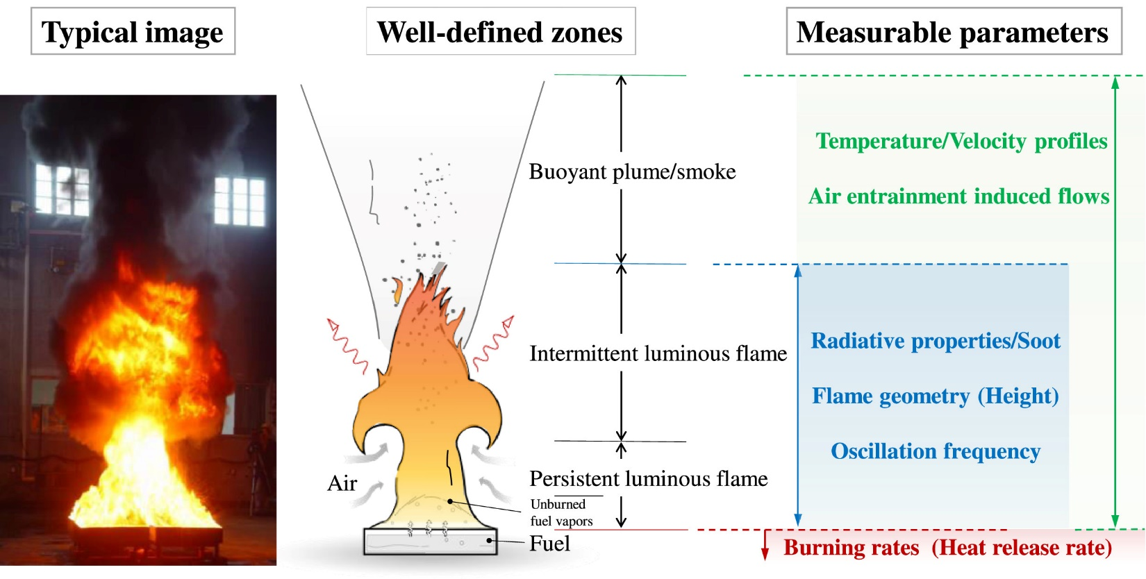
Pool fire:
burning of a flammable liquid typically resulting from a storage terminal, spill or leakage.
Zone of interest in this project
Yuhang Chen et al.,

Slide 3

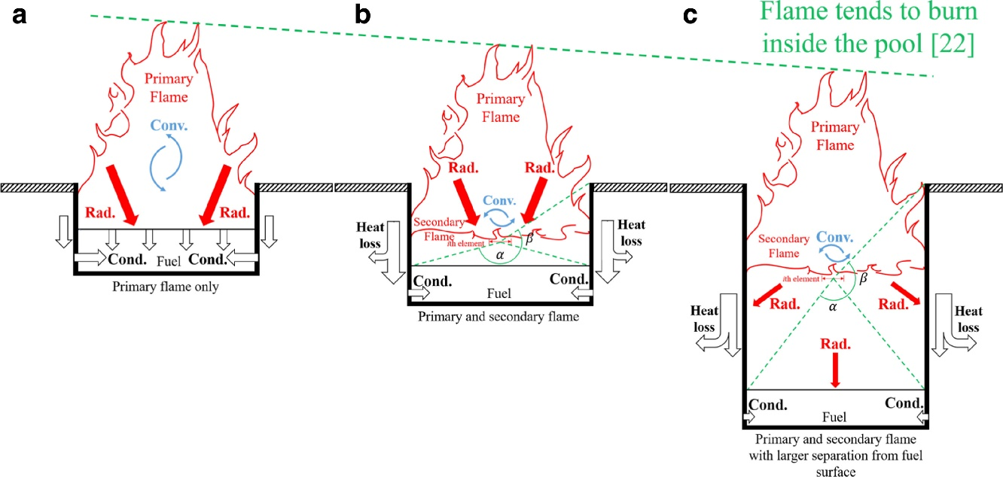
Lip effect
The height between fuel free surface and
Tray top is called Lip height.
As the lip height increases the
Flame temperature and burning
rate also varies.
Chen Kuang et al.,

Slide 4

Wind driven Pool fire:
williamstrial.com

Slide 5
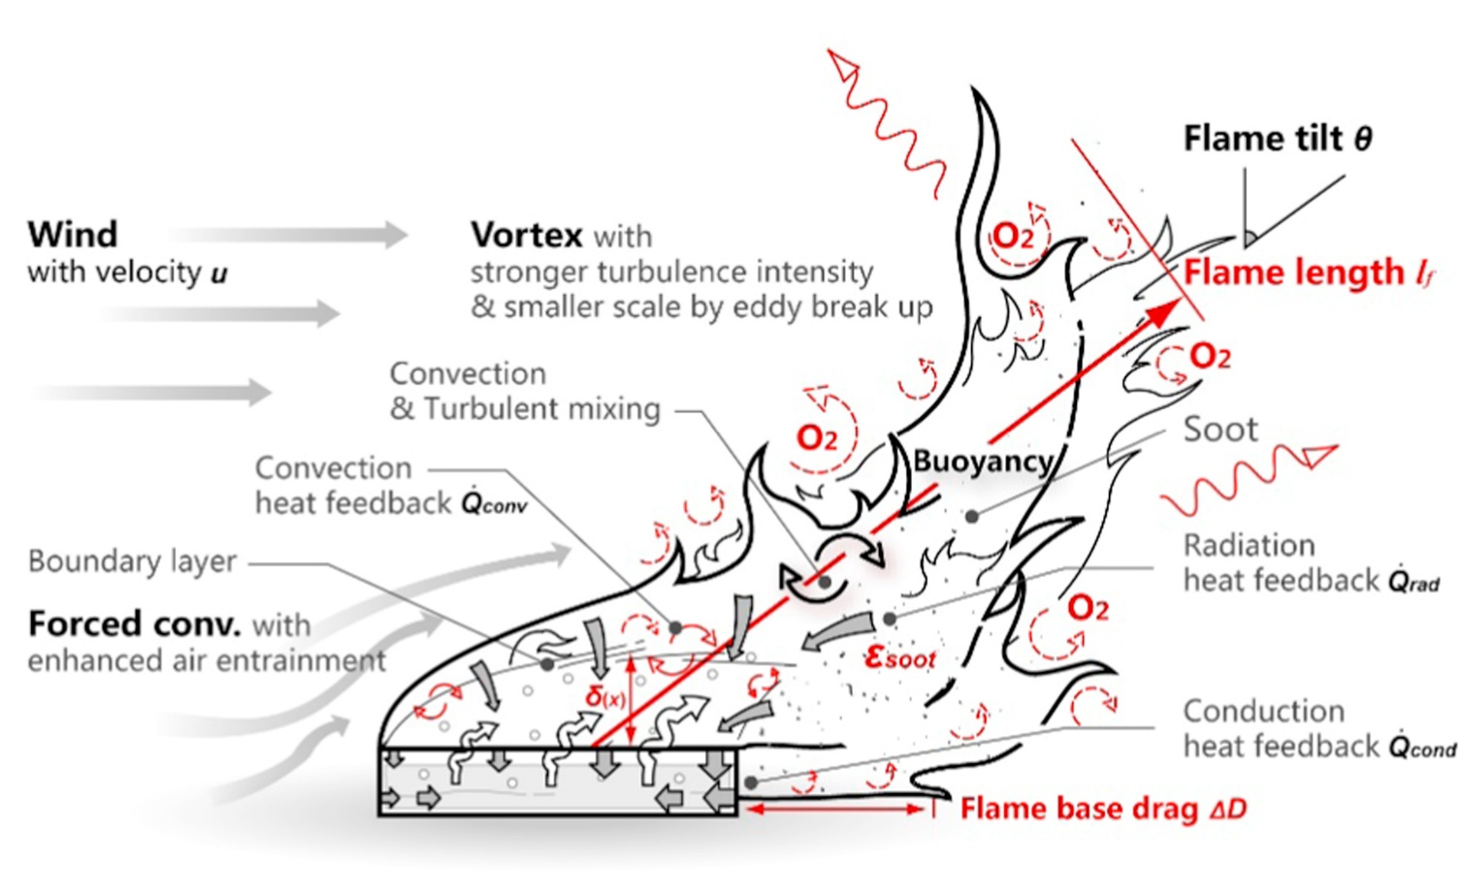
Physics of wind driven Pool fire:
Mass burning rate
rate
Flame temperature
Longhua Hu

Slide 6
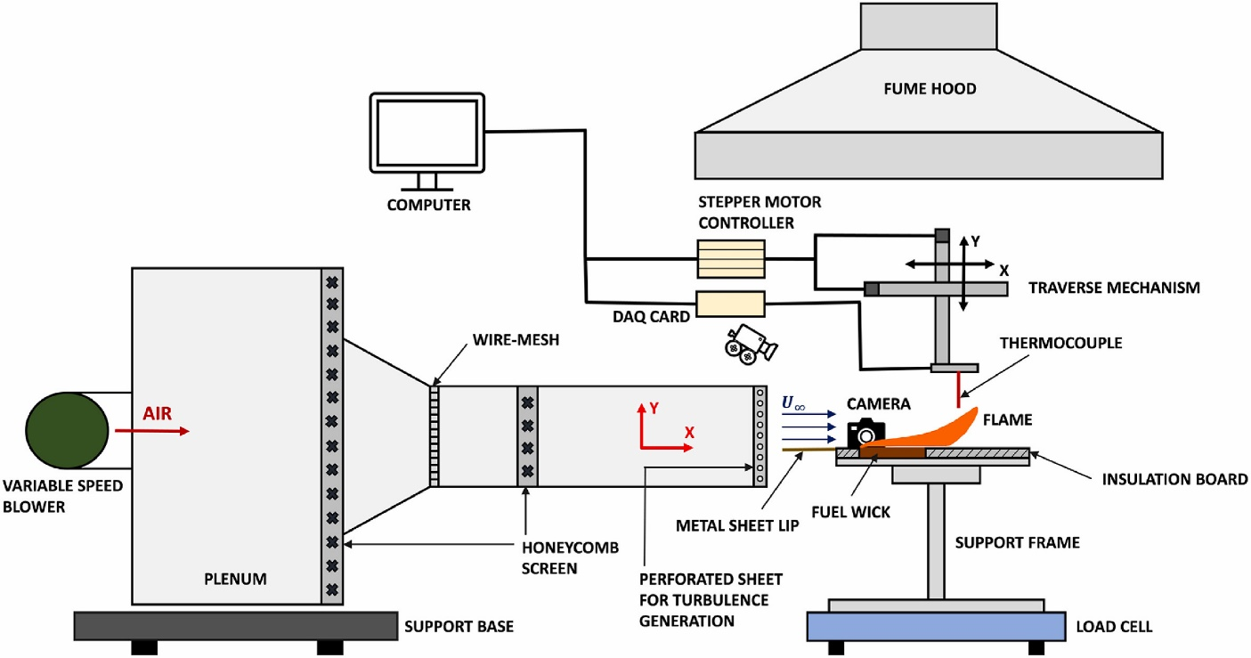
Experimental setup
180 ml Ethanol
R Type thermocouple
25cm×8cm steel tray
Wind tunnel velocity 1 m/s
Velmex X-Z Xslide™ traverse mechanism
CAPL, IIT Kanpur

Slide 7
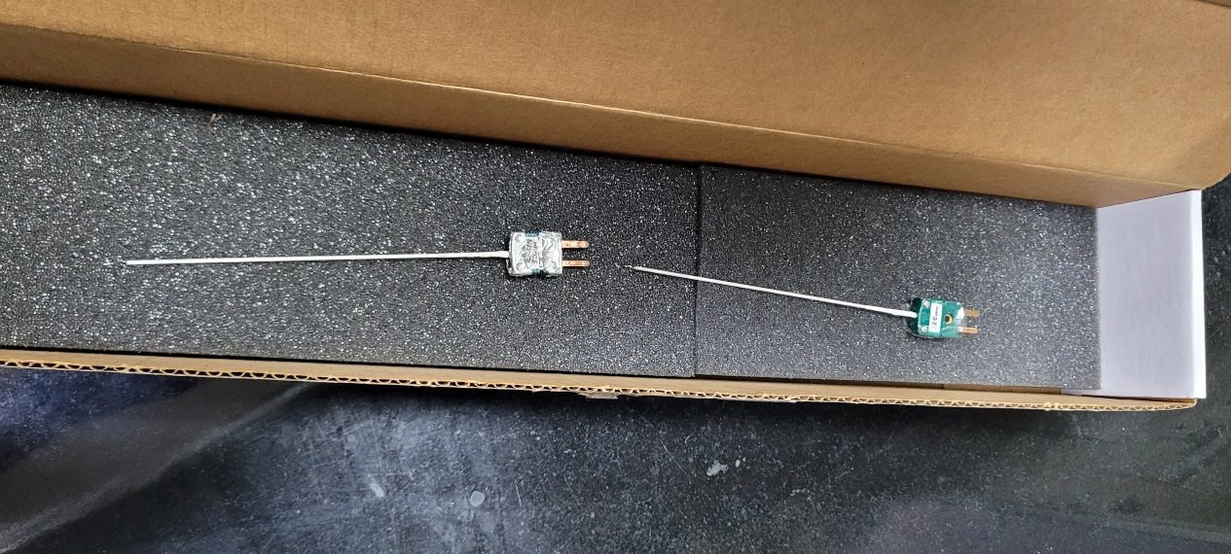
R Type thermocouple
A fine-wire R-type micro-thermocouple of 50 𝜇𝑚 (0.002 𝑖𝑛) diameter
maximum operating temperature of 2040 K.
Thermocouple wires:
positive leg : Alloy of 87% platinum and 13% rhodium
negative leg: Alloy of 99.99% platinum.

Slide 8
Hardware and Instrumentation
NI-9214(DAQ Module) is a high-density thermocouple input,
specification | value
Number of channels | 16 analog input channels
ADC resolution | 24 bits
Input Range | ±10V
https://www.ni.com/en-in/shop/model/ni-9214.html

Slide 9

cDAQ-9171 USB chassis
The analog signal acquired by the sensor was processed and digitized using a NI cDAQ 9171.
https://www.ni.com/en-in/shop/model/cdaq-9171.html

Slide 10
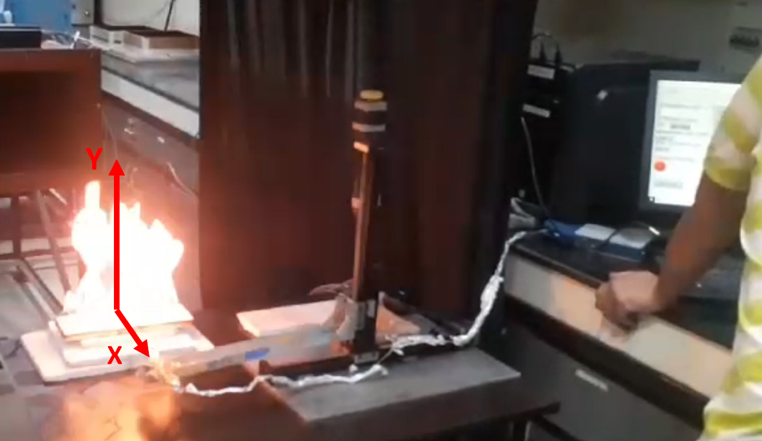
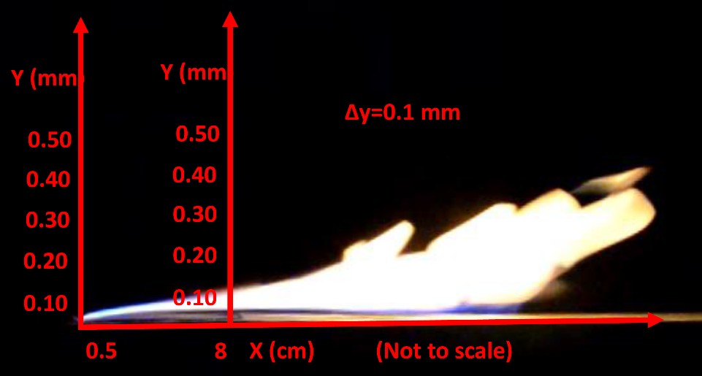
Temperature measurement
Before starting the tunnel:
Velocity=0 m/s
Wind tunnel Velocity=1 m/s

Slide 11
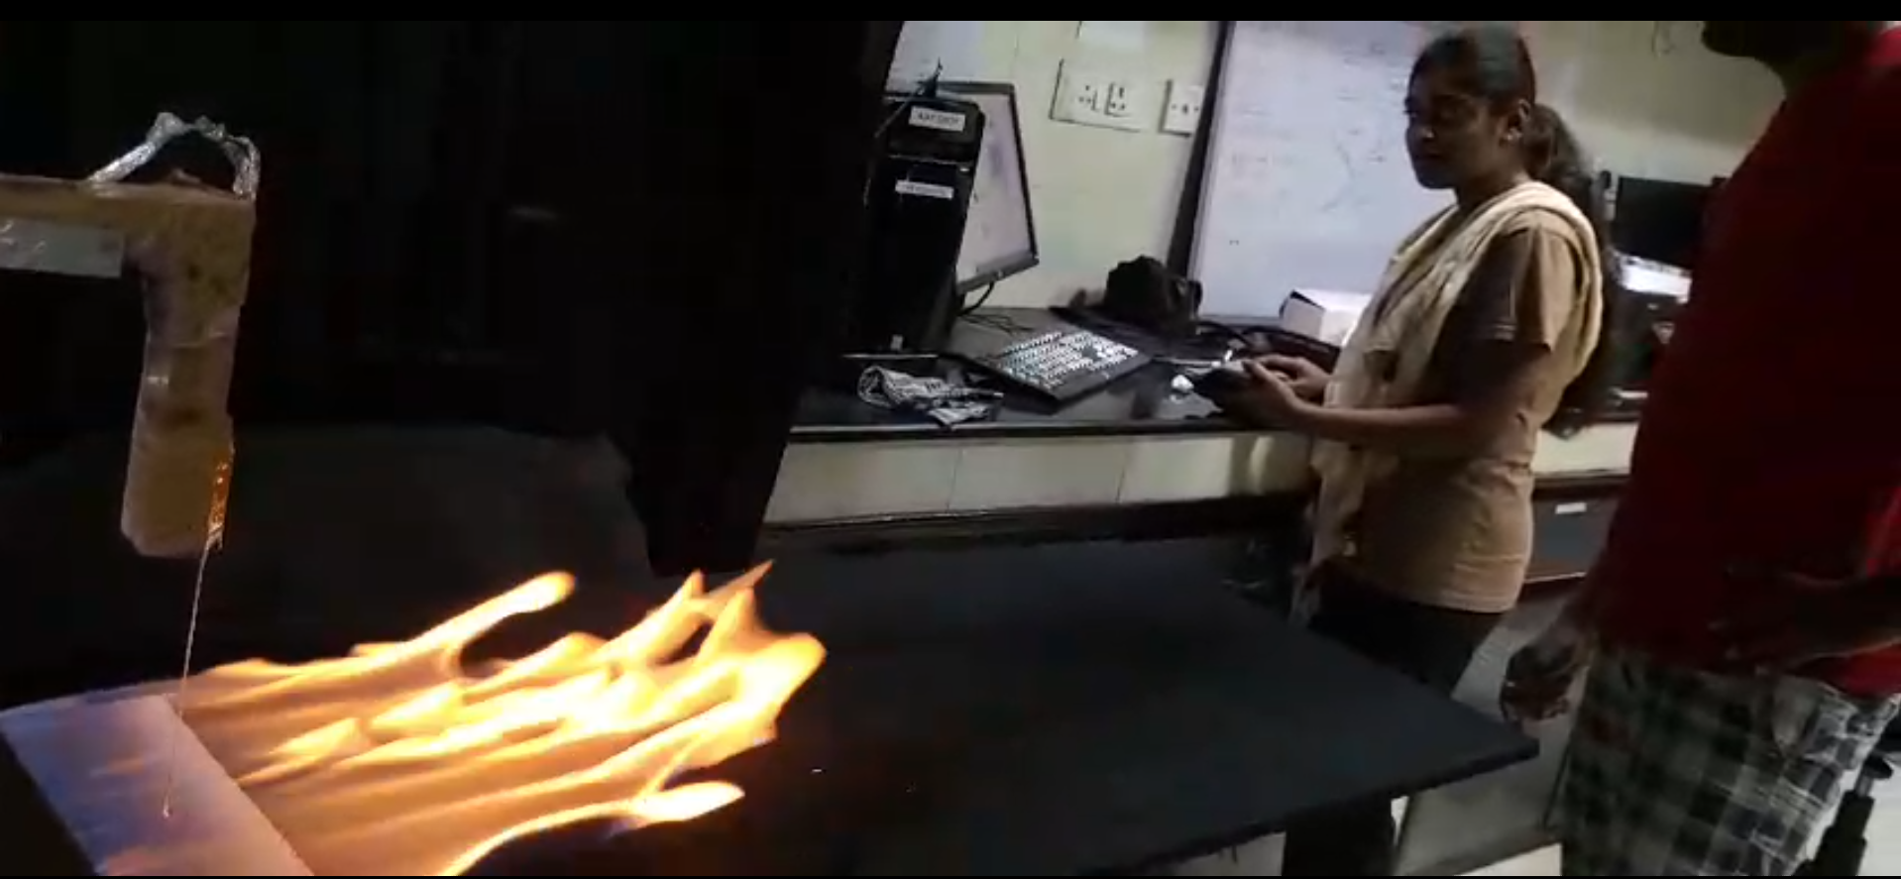

Slide 12
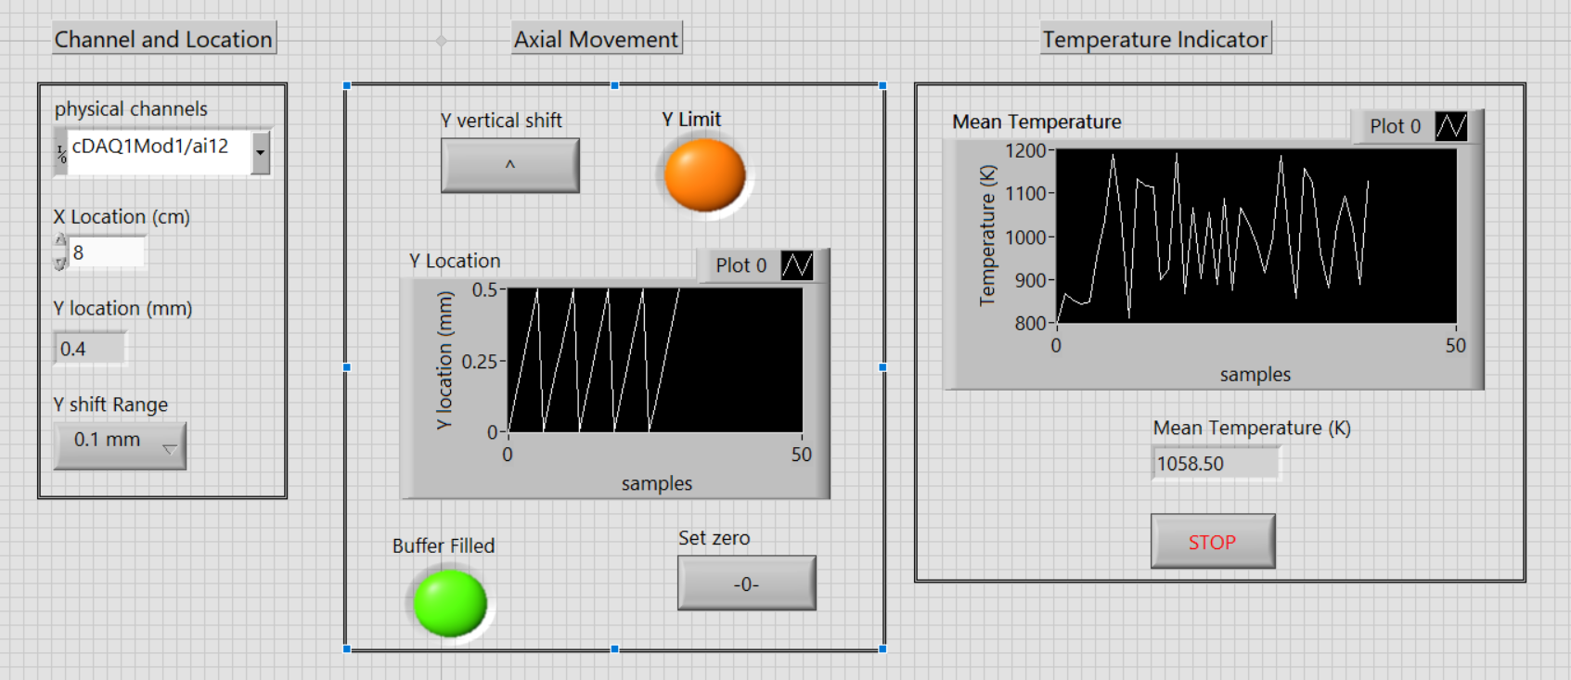
LabView Programming
Front Panel

Slide 13
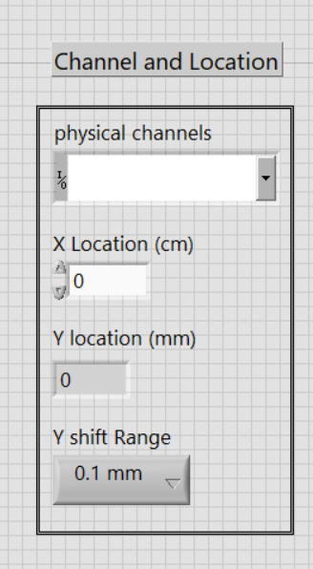
Front Panel
X position, Entered manually
Change in ∆y

Slide 14
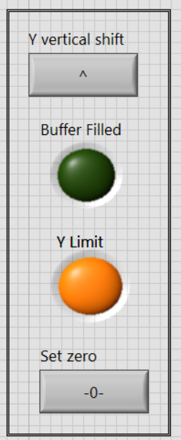
Changes the Thermocouple upwards by ∆y (0.1 mm)
Glows when 100 samples of data recorded.
Glows when maximum vertical movement (y=0.5 mm) reaches.
After reaching maximum limit, to bring the Vertical position to
Y=0 mm. Then will change the X location.

Slide 15
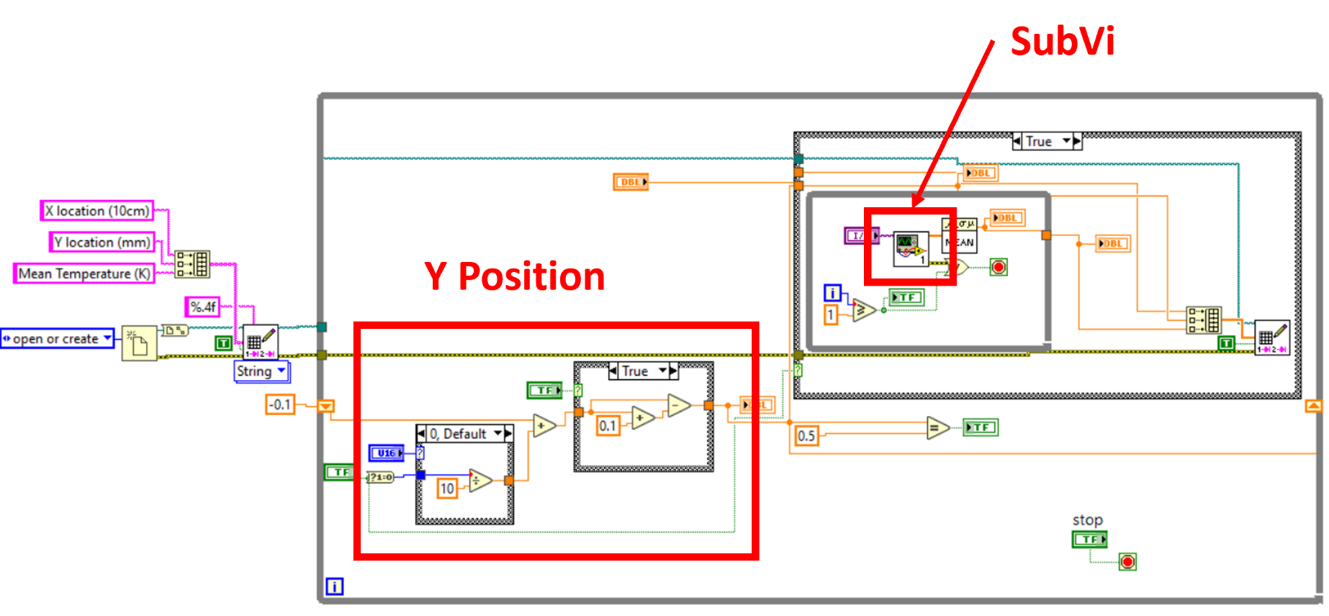
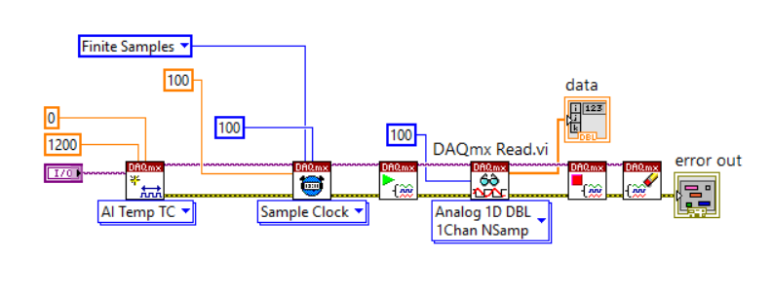
Block Diagram
SubVi DAQ

Slide 16
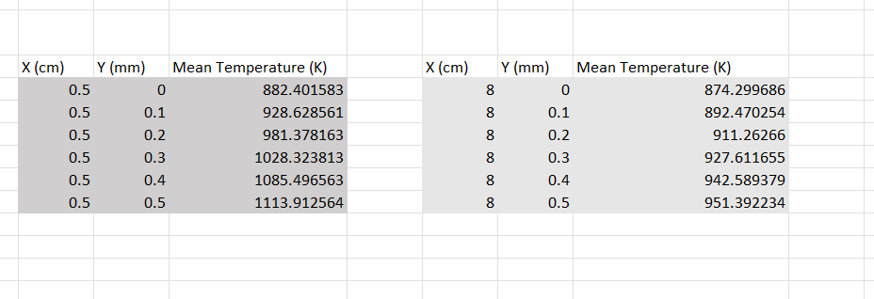

Slide 17
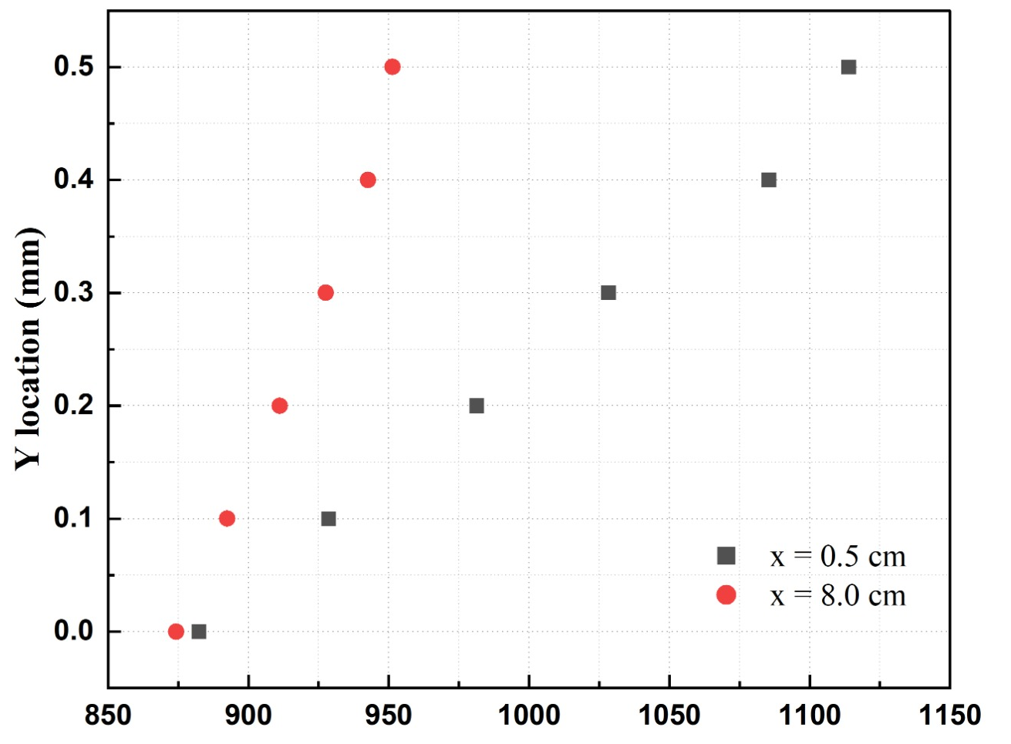

Results and discussion
Mean Temperature (K)

Slide 18
Conclusion
As we traverse along the x-axis, flame temperatures decrease,
whereas movement along the y-axis leads to temperature increase.
This result also demonstrates LabView capability in predicting the temperature profile of wind-driven pool fires

Slide 19
Future scope
Will vary this ∆y in large range(1 cm) to measure the flame temperature in the
Intermittent Zone
Buoyant Zone

Slide 20
References
Yuhang Chen, Jun Fang, Xiaolei Zhang, Yanli Miao, Yujie Lin, Ran Tu, Longhua Hu,
Pool fire dynamics: Principles, models and recent advances,Progress in Energy and Combustion Science,Volume 95, 2023, 101070,ISSN 0360-1285,
https://doi.org/10.1016/j.pecs.2022.101070.
https://www.williamstrial.com/blog/2020/december/six-workers-hospitalized-after-magellan-oil-tank/
Longhua Hu. A review of physics and correlations of pool fire behaviour in wind and future challenges. Fire Safety Journal, 91:41–55, 2017. Fire Safety Science: Proceedings of the 12th International Symposium.
Chen Kuang, Longhua Hu, Xiaolei Zhang, Yujie Lin, Larry W. Kostiuk, An experimental study on the burning rates of n-heptane pool fires with various lip heights in cross flow, Combustion and Flame, Volume 201, 2019, Pages 93-103,
ISSN 0010-2180, https://doi.org/10.1016/j.combustflame.2018.12.011.

Slide 21
Thank you

Slide 25
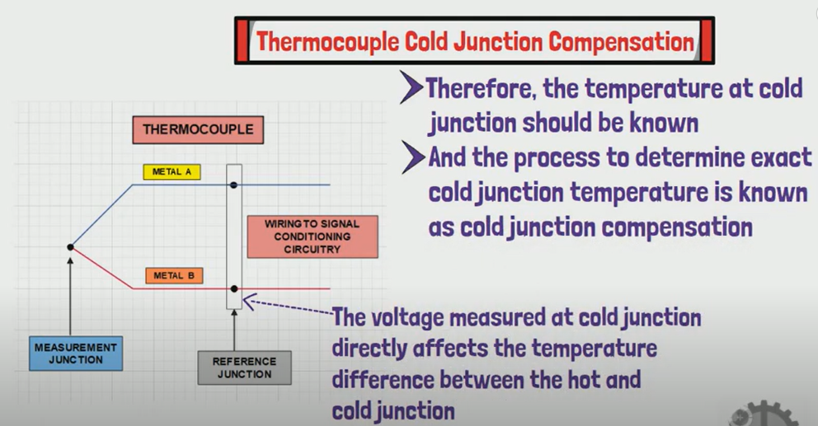
Cold junction compensation (CJC):
is a technique used to compensate for temperature variations at the junction between a thermocouple and the measuring instrument (often referred to as the "cold junction"). In a thermocouple-based temperature measurement system, the voltage generated by the thermocouple is proportional to the temperature difference between the measurement junction (where the temperature is being measured) and the reference junction (the cold junction, typically at the point where the thermocouple connects to the measuring instrument).

Slide 26
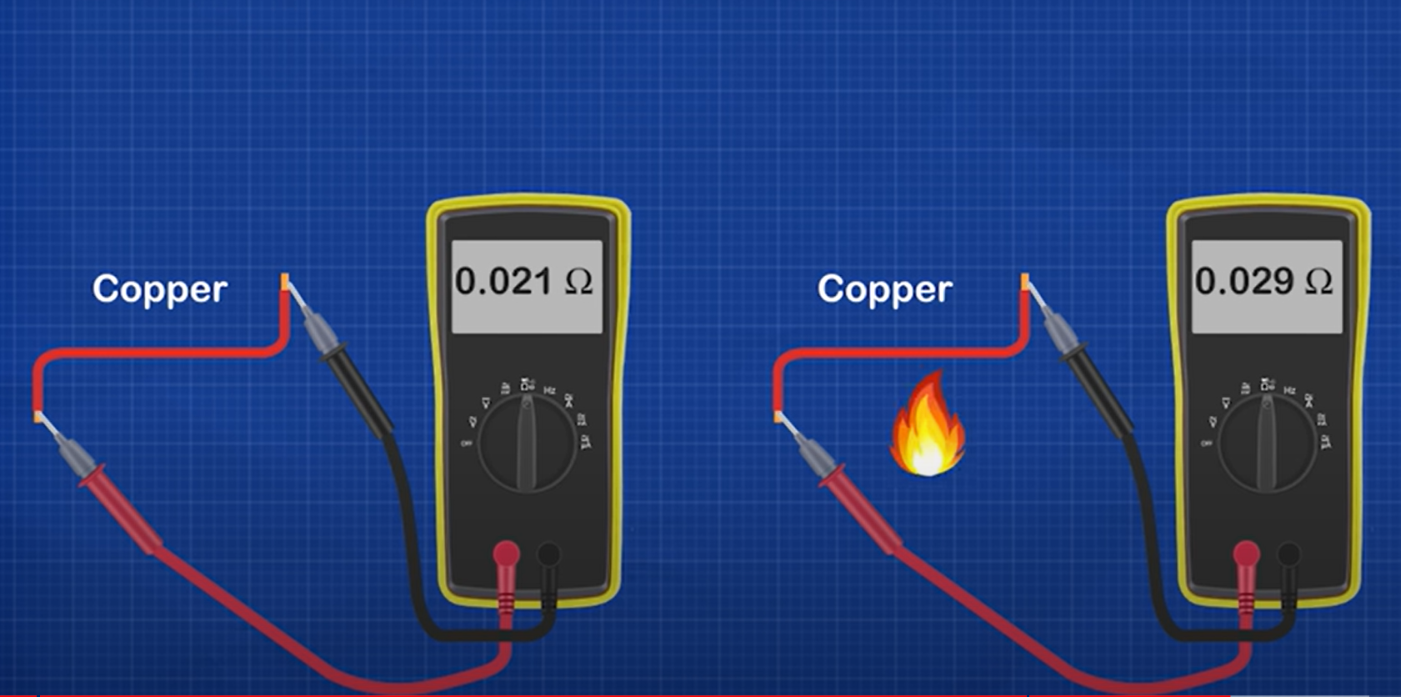
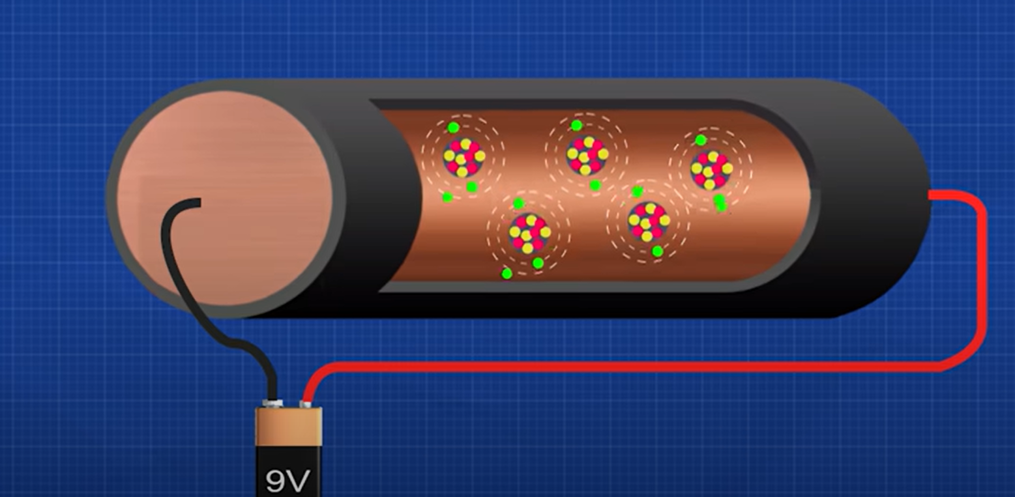
RTD:
RTD (Resistance Temperature Detector) and thermocouple are two distinct types of temperature sensors commonly used in industrial, scientific, and commercial applications. While both are used for temperature measurement, they operate on different principles.
Due to increase in energy the atom vibrates at high speed resisting the currently flow smoothness. Creates a volt difference.

Slide 27
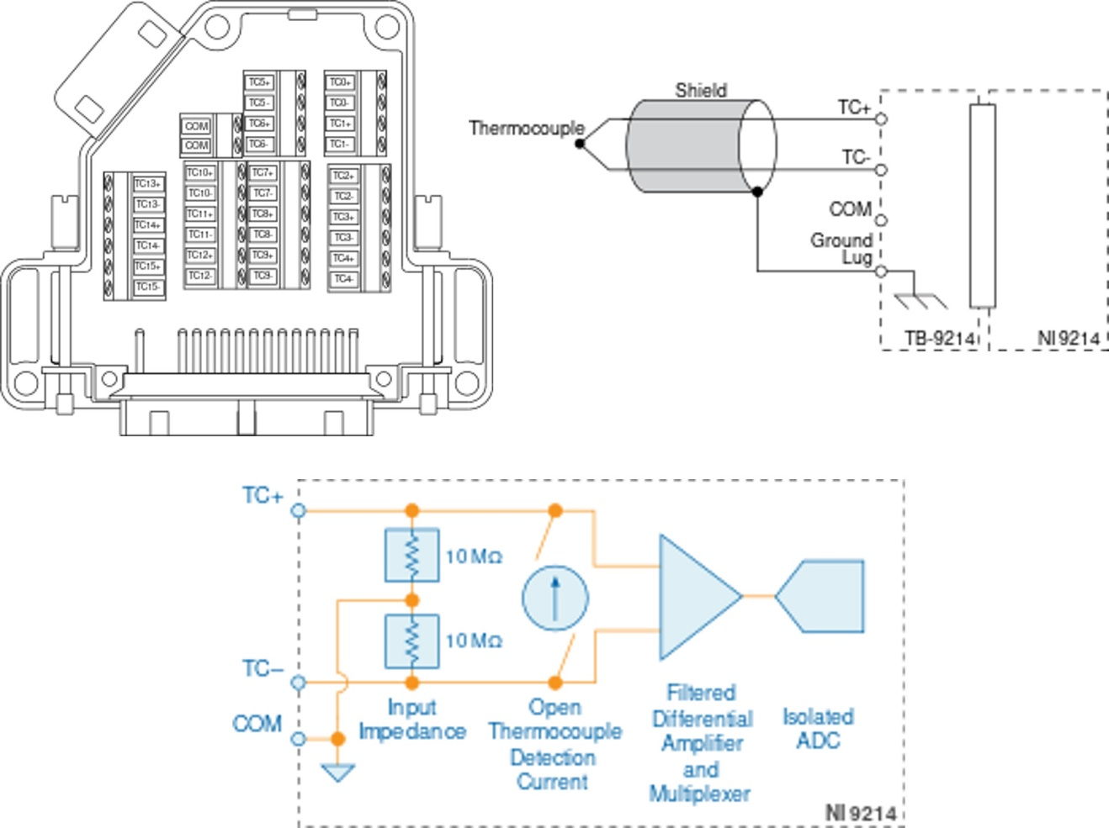
NI-9214 is a high-density thermocouple input
It's commonly used in industrial and laboratory settings for measuring temperature using thermocouples.

Slide 28
The NI-9214 high-density thermocouple input module has several specifications that make it suitable for various temperature measurement applications. Here are some of its key specifications:
Number of Channels: The NI-9214 typically offers 16 channels for thermocouple input.
Thermocouple Types: It supports various types of thermocouples, including J, K, R, S, T, N, E, and B types.
Measurement Accuracy: Accuracy can vary depending on factors such as thermocouple type, temperature range, and calibration. Generally, NI specifies accuracy within a certain temperature range, typically around ±1°C to ±2°C.
Input Range: The input range for thermocouple voltage measurement is typically around -78 mV to 78 mV, which corresponds to the temperature range of the supported thermocouple types.
Sample Rate: The NI-9214 offers a maximum sample rate per channel, which can vary depending on the specific model and configuration. It's usually in the range of tens to hundreds of samples per second per channel.
Resolution: The module typically offers a resolution of 24 bits, providing high-resolution temperature measurements.
Isolation: The NI-9214 often features channel-to-channel and channel-to-ground isolation to minimize noise and ensure accurate measurements.
Compatibility: It is designed to work with National Instruments CompactDAQ and CompactRIO platforms, and it's typically compatible with NI-DAQmx software for configuration, control, and data logging.
Form Factor: The NI-9214 is often designed to fit into a CompactDAQ chassis or a CompactRIO system, offering flexibility in system integration.
These specifications may vary slightly depending on the specific model and configuration of the NI-9214 module. It's always essential to refer to the official documentation or datasheet for the most accurate and up-to-date information.

Slide 29
cDAQ-9171 USB chassis
The CompactDAQ 9171 chassis serves as the physical enclosure and infrastructure for building modular data acquisition systems. Here's what it does:
Housing for DAQ Modules: The primary function of the CompactDAQ 9171 chassis is to house one or more data acquisition (DAQ) modules. These modules perform specific measurement tasks, such as analog input, analog output, digital I/O, or specialized measurements like temperature or vibration sensing.
Power Supply: The chassis provides power to the installed DAQ modules. It ensures that each module receives the necessary electrical power to operate correctly.
Data Communication: The chassis facilitates communication between the installed DAQ modules and an external computer or controller. This communication enables data transfer, control commands, and synchronization signals between the modules and the host system.
Synchronization: It supports synchronization of measurements across multiple DAQ modules within the same chassis. This synchronization is essential for applications that require precise timing and coordination between different measurement channels.
Signal Conditioning: Some CompactDAQ chassis models may include built-in signal conditioning capabilities, such as filtering or amplification, to enhance the quality of acquired data.
Environmental Protection: The chassis provides physical protection for the installed DAQ modules, shielding them from environmental factors such as dust, moisture, and mechanical shock. This protection ensures the reliability and longevity of the measurement system, especially in industrial or field environments.
Modularity and Flexibility: One of the key advantages of CompactDAQ chassis is their modular design. Users can easily swap or add DAQ modules to customize the system based on their specific measurement requirements. This modularity offers flexibility and scalability, allowing users to adapt the system to changing needs or applications.
In summary, the CompactDAQ 9171 chassis acts as the central hub for assembling a modular data acquisition system, providing power, communication, synchronization, and environmental protection for the installed DAQ modules.

Slide 30
Traverse mechanism

Slide 31
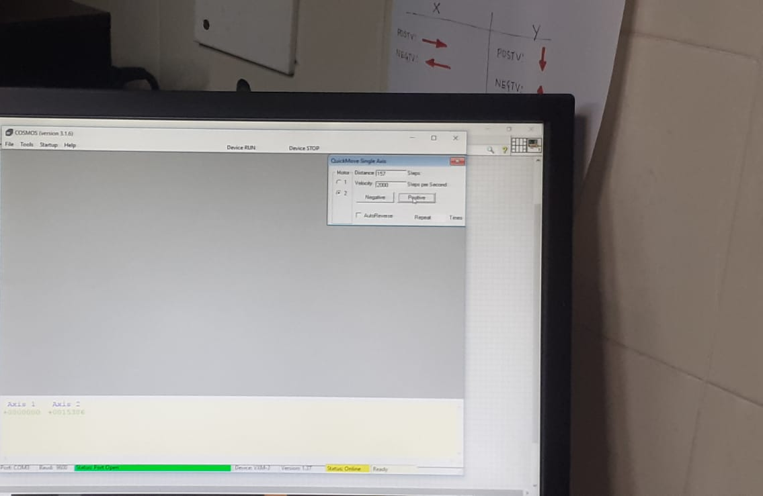
Traverse mechanism

Slide 32
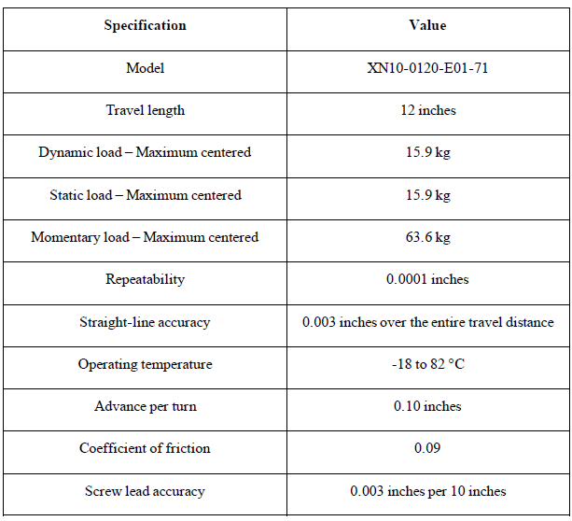

Slide 33
Wind tunnel:
220 RPM

Slide 34
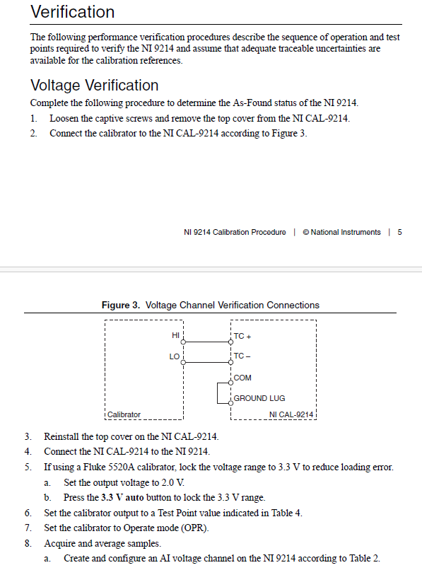
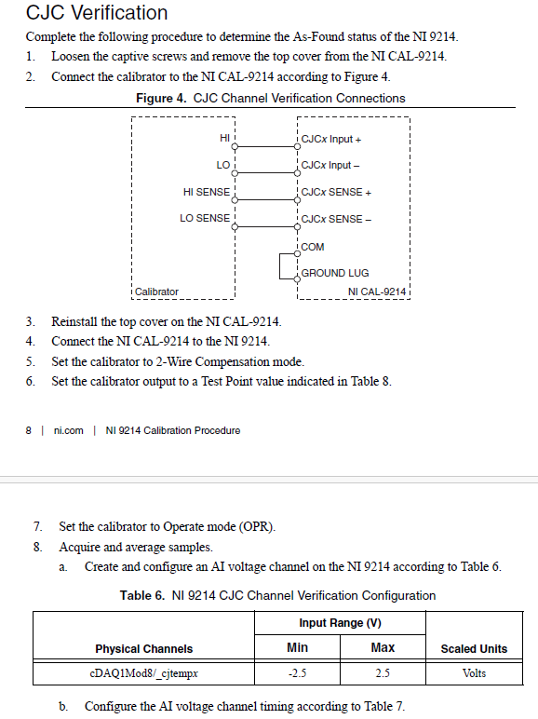
Thermocouple calibration

Slide 35
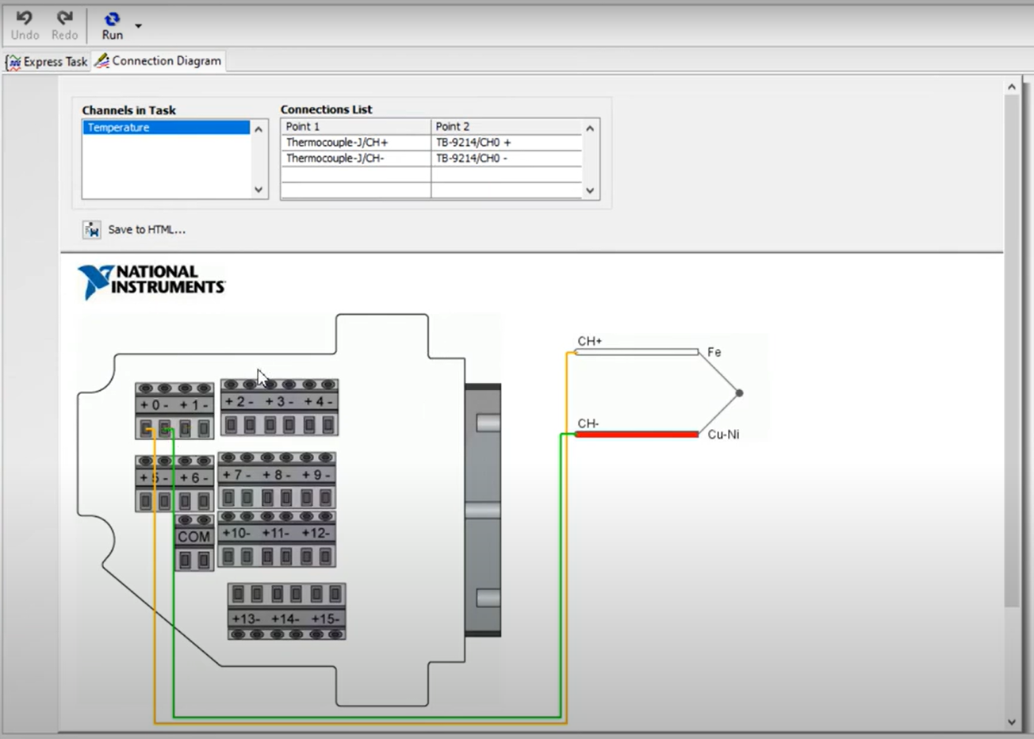

Slide 36
